Slide 1
Detecting Violation of Helmet Rule for Motorcyclists
Presenter: 陳郁仁
E-mail: b11902113@ntu.edu.tw
Phone: 0902358658

Slide 2
Data
100 videos with ground truth bounding box
Each video is 20 seconds, 10 fps
Resolution: 1,920 x 1,080 pixels

Slide 3
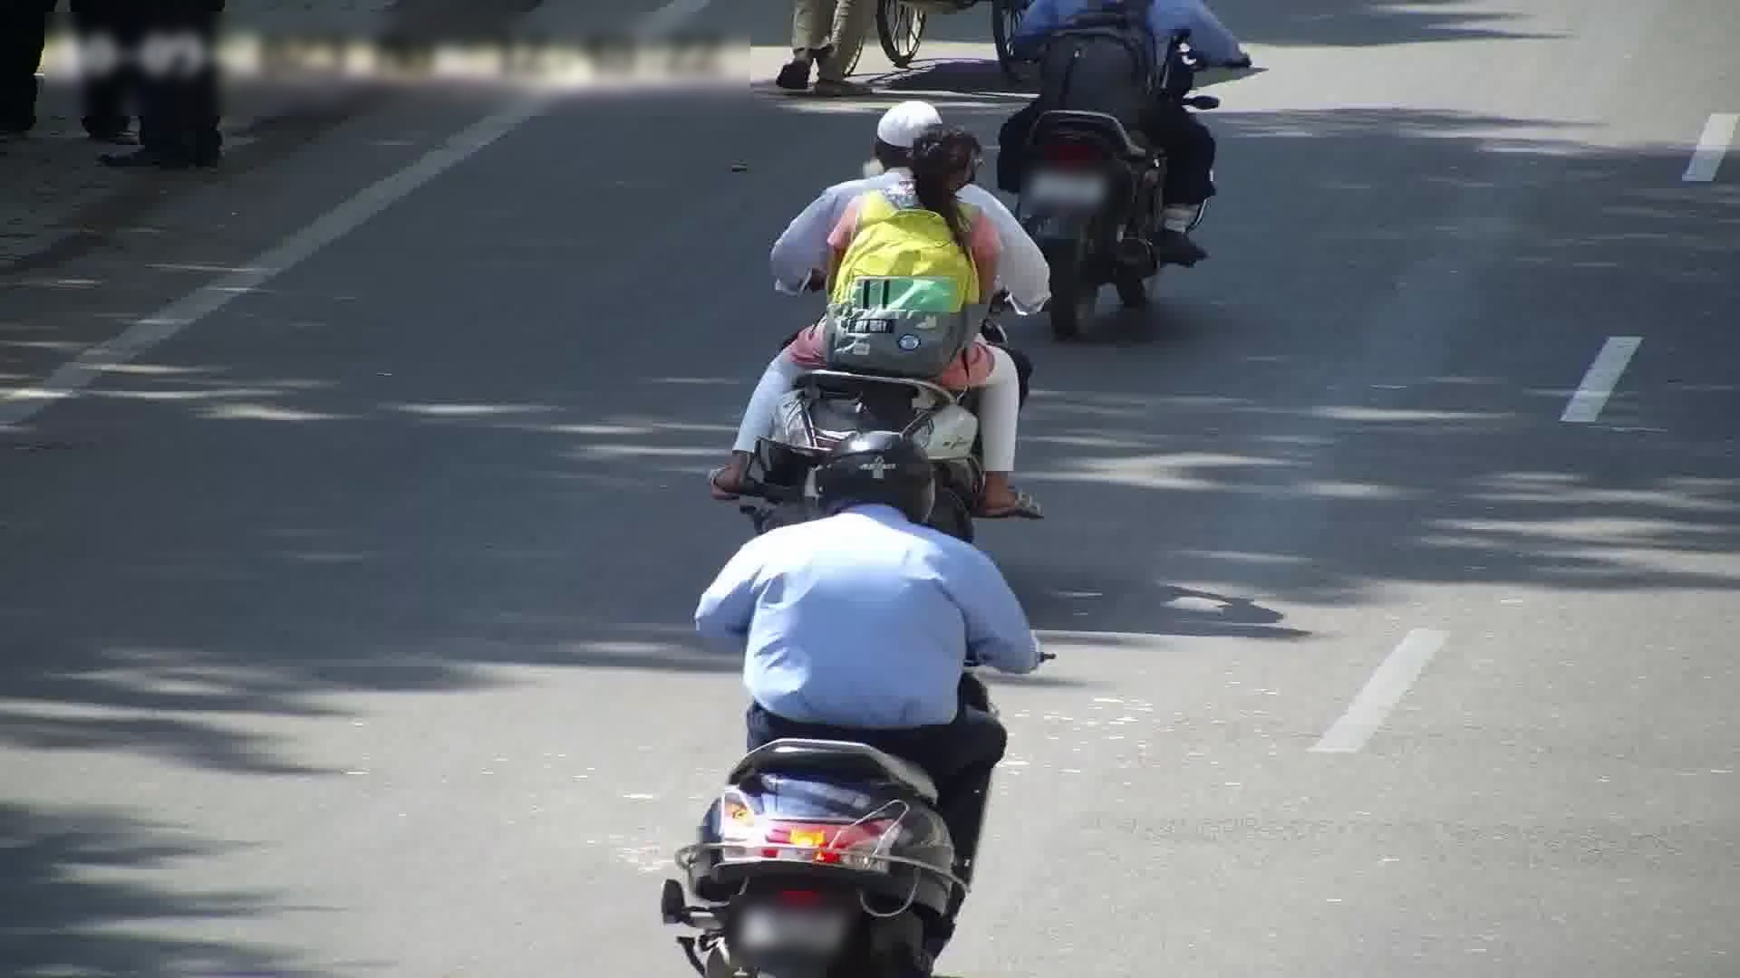
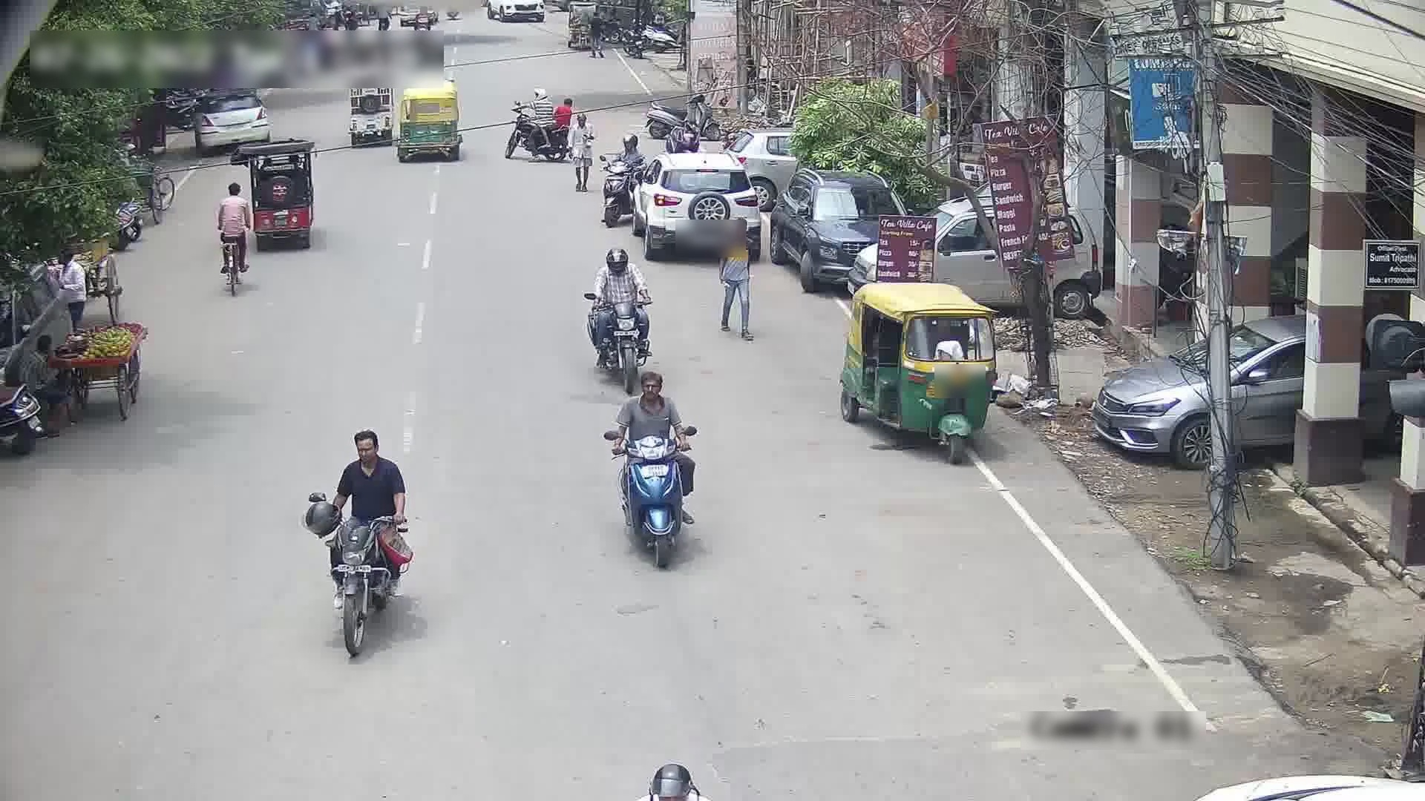
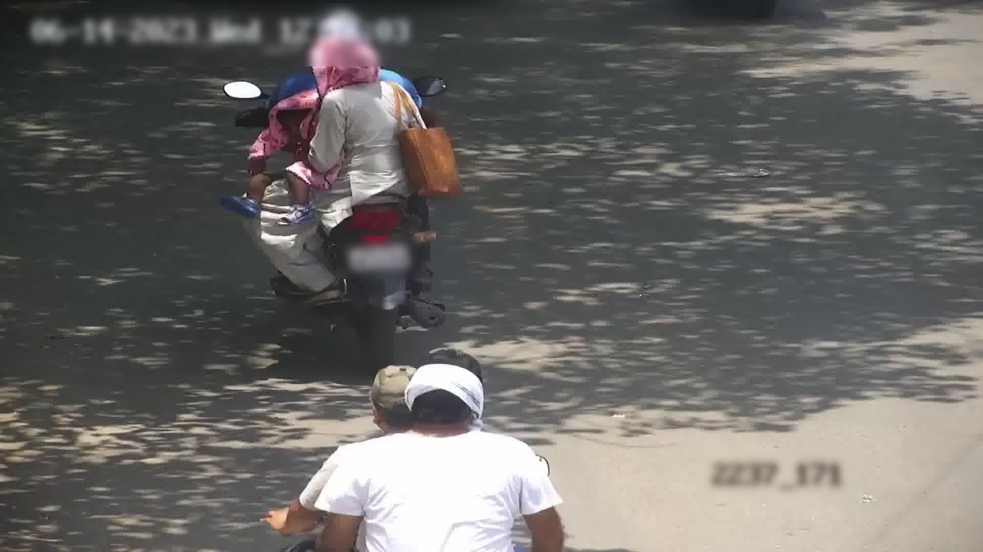

Slide 4
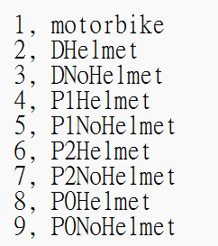
Labels

Slide 5
Labels

Slide 6
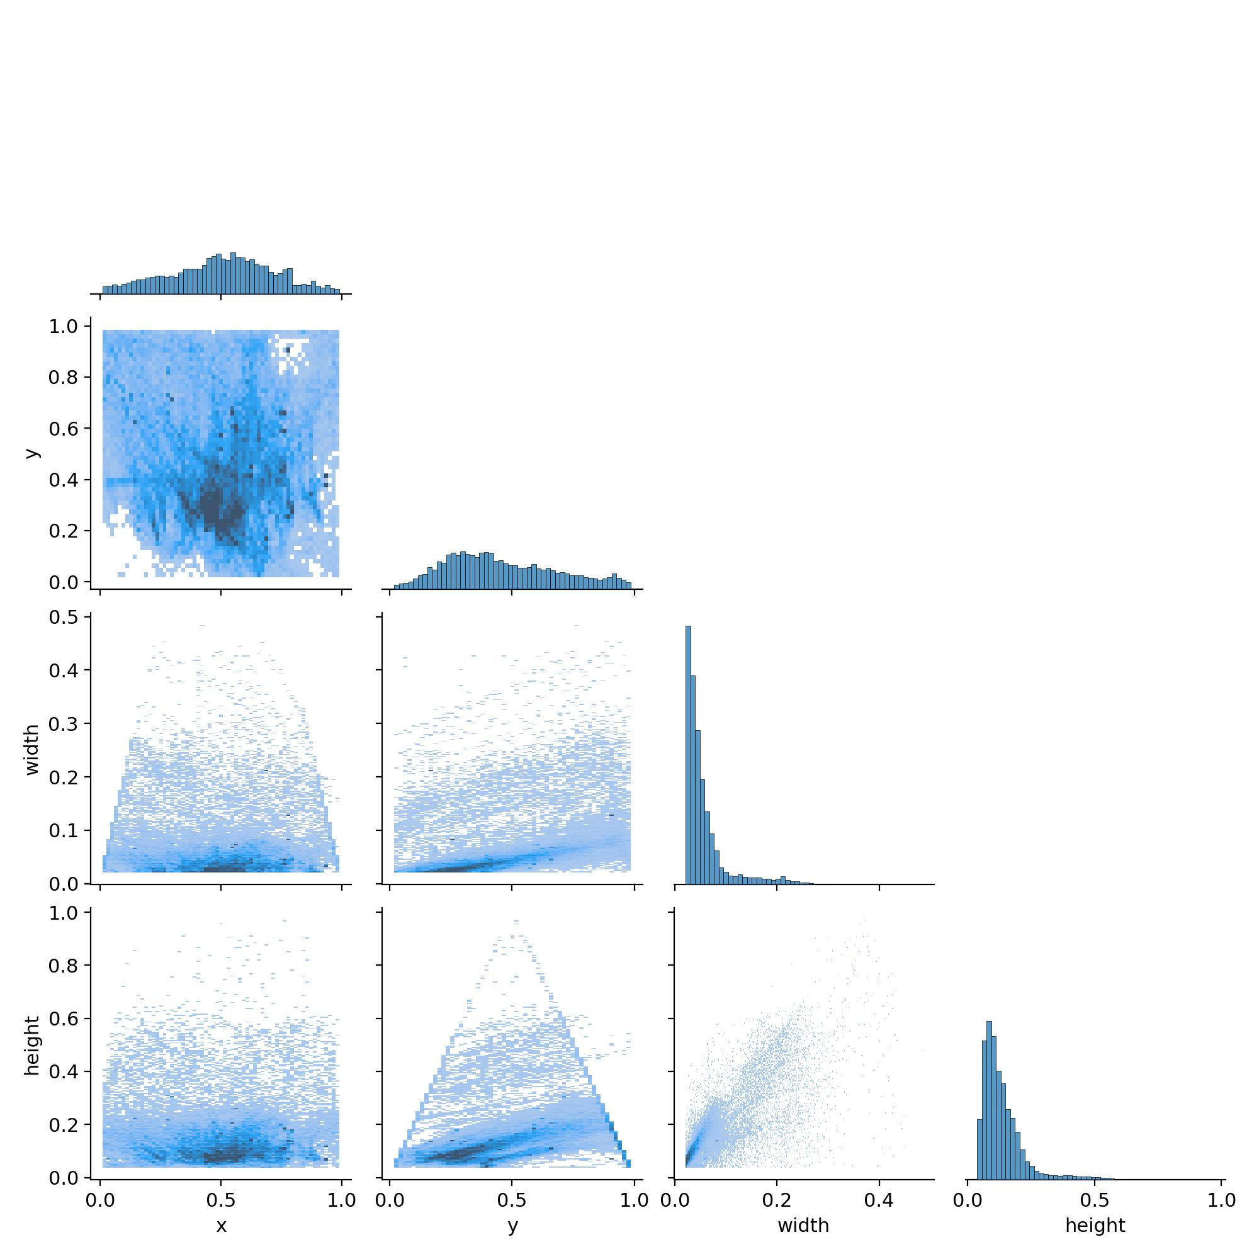
Data set

Slide 7
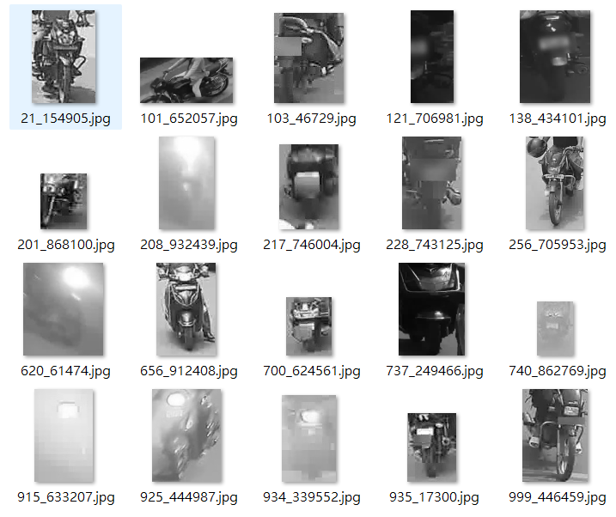
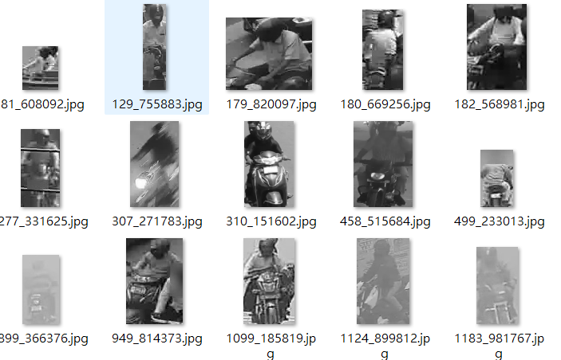
Data set
motorcycles
Training: 80%
Validation: 10%
Testing: 10%
Driver with helmet

Slide 8
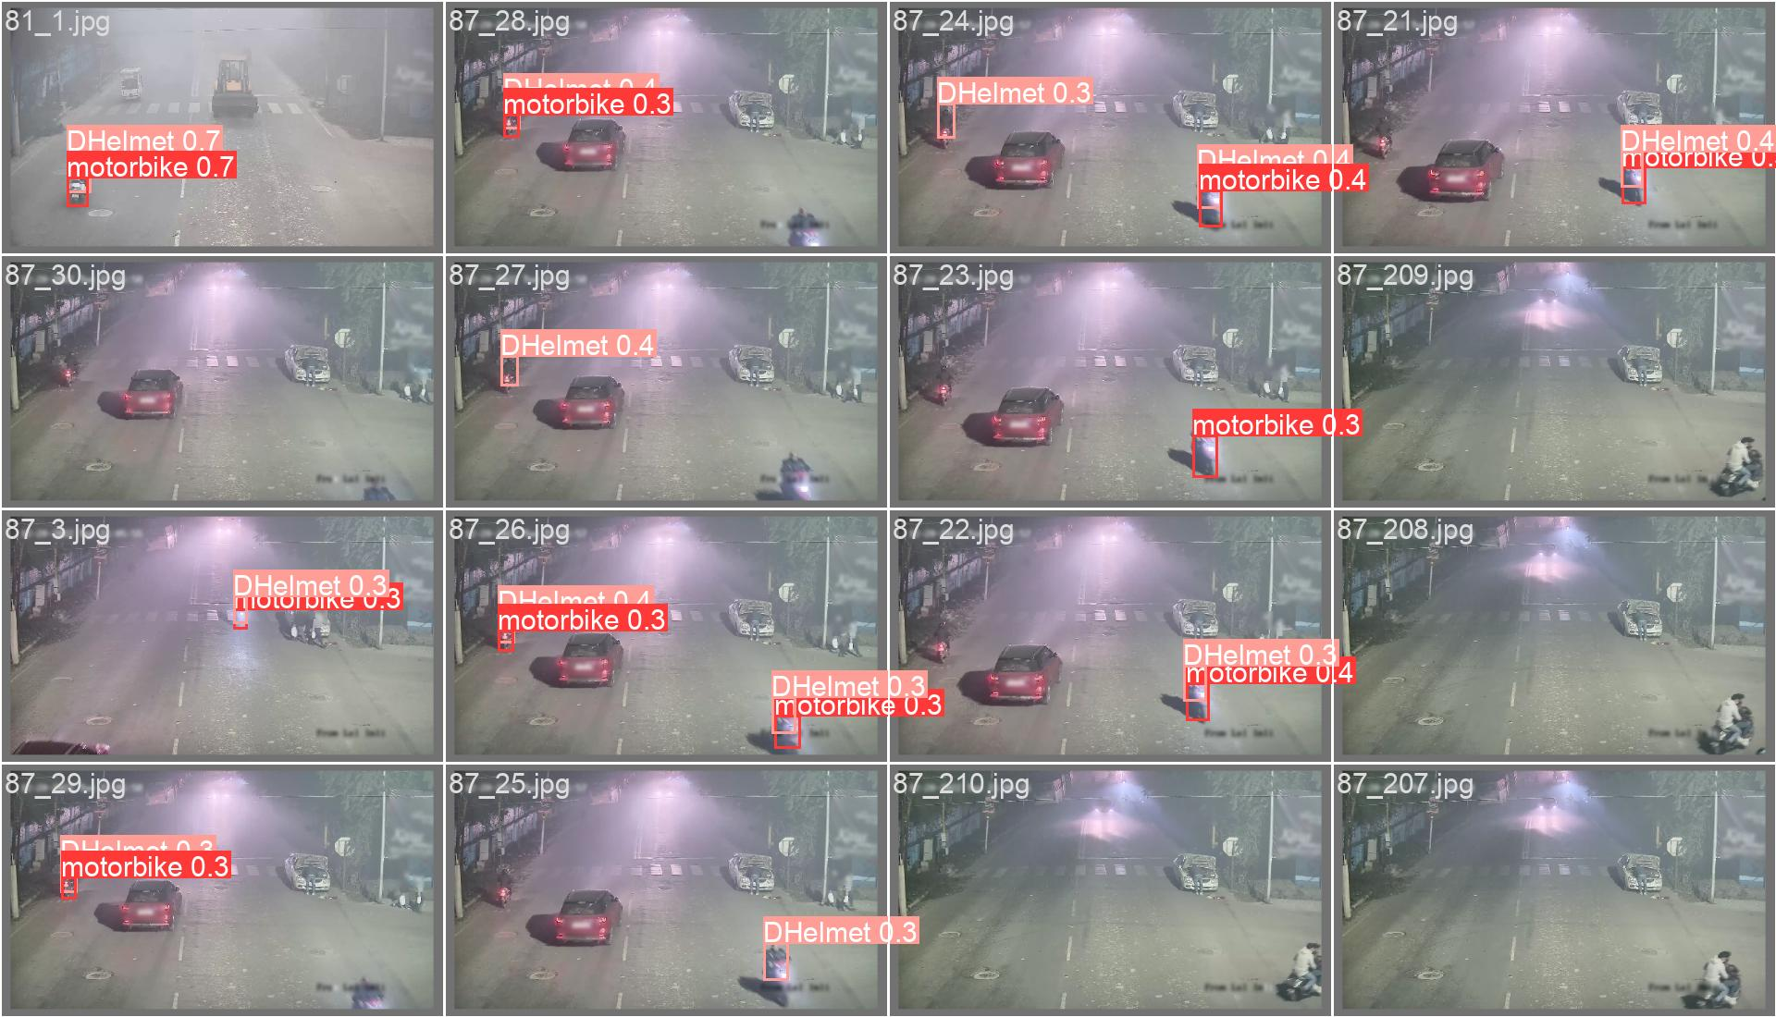
YOLOv8 (You Only Look Once version 8)
Ground truth
Prediction

Slide 9
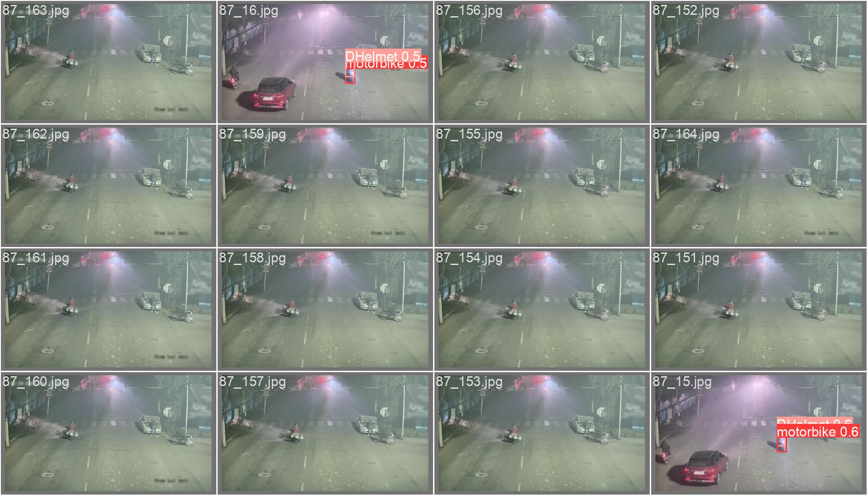
YOLOv8
Ground truth
Prediction

Slide 10
YOLOv8

Slide 11
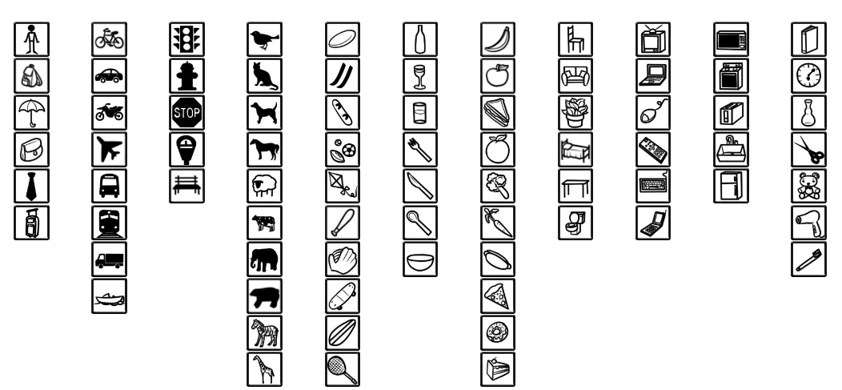
YOLOv8, pretrained
COCO (Common Object in Context) dataset
Person and
Motorcycle

Slide 12
YOLOv8, pretrained

Slide 13
YOLOv8, pretrained

Slide 14
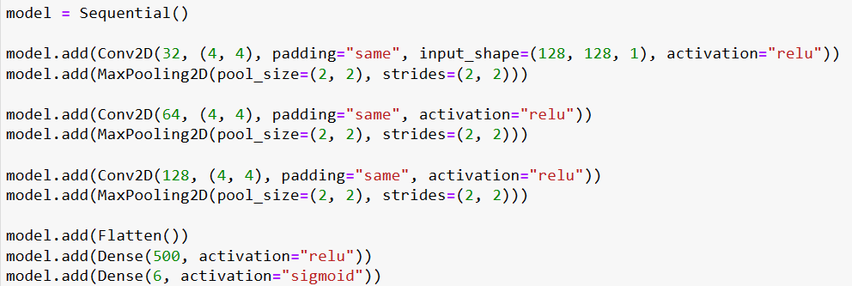
CNN
Three convolutional layers

Slide 15
CNN Training
CPU: Intel i9 with 30,000 grayscale images (128 x 128 pixels)
Training time: about 1 hour.
Test set accuracy: 82.8%

Slide 16
Summary
Method: Using YOLOv8 and CNN to determine whether the motorcyclist or passenger is wearing a helmet or not.
Steps: Training YOLOv8 and CNN models => Using YOLOv8 to detect the bounding boxes of motorcycles and riders => Using CNN to identify whether riders and passengers are wearing helmets.
Results: Whether a driver or passenger is wearing a helmet can be correctly identified.

